Slide 1


K.RAMAKRISHNAN COLLEGE OF TECHNOLOGY
(AUTONOMOUS), TRICHY.
DEPARTMENT OF
COMPUTER SCIENCE AND ENGINEERING
20CS5501 DESIGN PROJECT-1
Batch No. : 8
Date : 06.12.2024

Slide 2
WHATSAPP MESSAGE EXTRACTION AND STORAGE SYSTEM
Team
Guided by
Mr.R Rajavarman, M.E.,(Ph.D).,
Assistant Professor, CSE
Kavin S (81172104072)
Prasanth P (811722104110) Praveen P (811722104111)

Slide 3
OBJECTIVE OF THE PROJECT
Develop an automated script to interact with WhatsApp Web and retrieve messages based on specified groups or private chats.
Extract key data fields including the sender’s name, message contents. Ensure accurate parsing and formatting of the retrieved message data.
Design a structured Excel sheet to store the extracted data, with columns for sender, message.
Implement automation to periodically fetch new messages and update the Excel sheet. Set up scheduled tasks to run the script at regular intervals for continuous data collection.

Slide 4
ABSTRACT
In today’s digitally connected world, messaging platforms like WhatsApp serve as vital tools for personal and professional communication. This project aims to develop an automated system to fetch messages from WhatsApp and store them in an Excel sheet based on specified groups or private chats. The primary objective is to facilitate organized data storage and analysis of WhatsApp messages for both individual and group communications.

Slide 5
LITERATURE SURVEY
TITLE OF THE PAPER | AUTHOR (S) | PUBLISHER | PAPER GIST | TECHNOLOGY USED
Signature identification and user activity analysis on WhatsApp Web through network data (2023) | Ramraj S, Usha G. | Microprocessors and Microsystems | The paper analyzes network traffic from WhatsApp Web to identify patterns in encrypted SSL communications, including user activities and message statuses | Secure Socket Layer (SSL)/Transport Layer Security (TLS) Analysis. Data Visualization
Students’ Views on the Use of WhatsApp during Covid-19 Pandemic: A Study at IAIN Batusangkar(2020) | Sirajul Munir1 , Rita Erlinda2 , Hanif Afrinursalim3 | Indonesian Journal of English Language Teaching and Applied Linguistics | The study investigates students' perceptions of using WhatsApp for English classes during the COVID-19 pandemic | Selenium web scrapping, Data Management Tools:Excel,
Automation Using Selenium (2006) | Dr.V.Suganthi, M.M.Varun | International Journal Of Multidisciplinary Research In Science, Engineering and Technology (IJMRSET) | The "Automation Using Selenium" project uses Selenium and Python to automate web scraping tasks extracting data efficiently. | Selenium, BeautifulSoup, openpyxl.

Slide 6



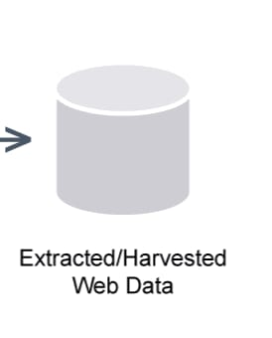

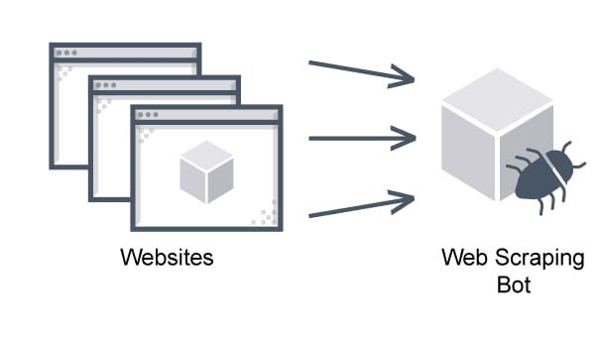
PROPOSED SYSTEM ARCHITECTURE

Slide 7
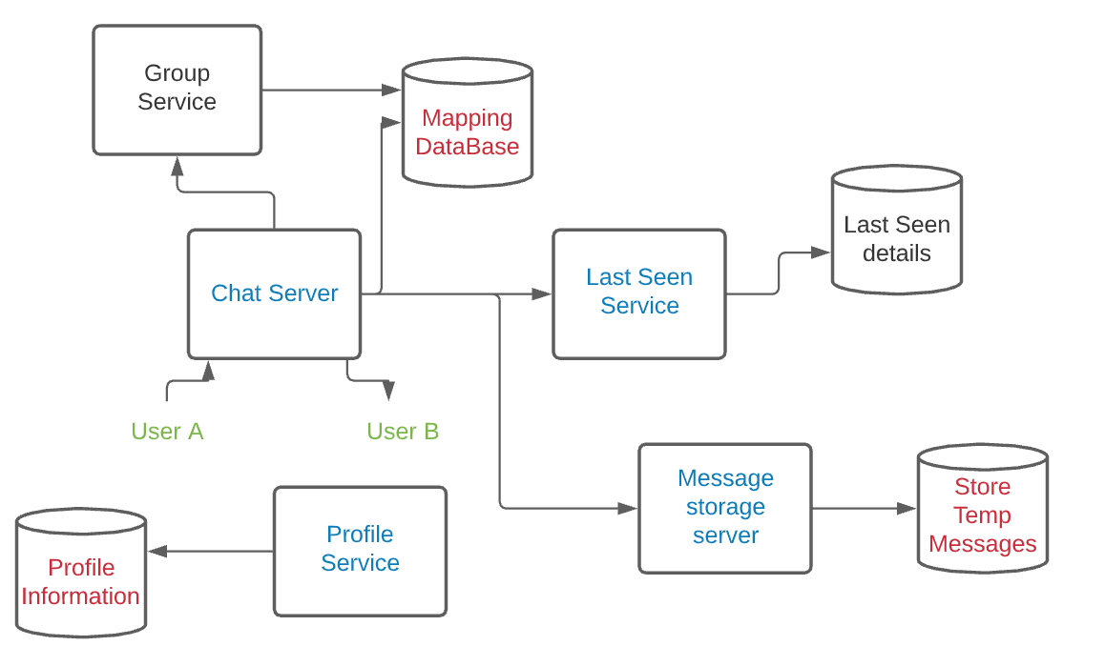
EXISTING SYSTEM ARCHITECTURE

Slide 8
SOFTWARE AND HARDWARE REQUIREMENTS
HARDWARE
SOFTWARE
Operating system: Windows 7 or 7+
Processor: Intel i3 or Ryzen 3
RAM: 2 GB MEMORY
Hard disc or SSD : More than 1GB
Software’s: Python Selenium 4.24.0 Chrome driver Excel
IDLE: OpenPyXL.

Slide 9
MODULES
WhatsApp Web Automation Module
Message Data Extraction Module
Data Parsing and Formatting Module
Automation and Scheduling Module
Excel Storage Module

Slide 10
SUMMARY OF MODULE-1
WhatsApp Web Automation Module :
This module is responsible for automating the process of logging into WhatsApp Web and accessing specific chats or groups.
It uses a tool called Selenium, which allows a script to control the web browser.
The module logs into WhatsApp Web, navigates to the desired group or private chat, and automatically scrolls through the chat history to load past messages.
This saves time by eliminating the need for users to manually open WhatsApp and retrieve messages.

Slide 11
SUMMARY OF MODULE-2
Message Data Extraction Module:
This module's job is to collect important details from WhatsApp messages, like the sender’s name, the message content, the time the message was sent, and whether it's from a group or private chat.
It uses Selenium to read and extract this information directly from WhatsApp Web. Once the messages are collected, they are organized and prepared for further steps, like storing them in an Excel sheet.
This module ensures that all message data is captured correctly and in an easy-to-read format.

Slide 12
SUMMARY OF MODULE-3
Data Parsing and Formatting Module:
This module ensures that the extracted WhatsApp messages are properly organized and easy to understand.
It takes the raw message data (like sender name, message text, and time) and arranges it neatly, separating each piece of information into the correct format.
This makes sure that the data is ready to be stored in the Excel sheet in a clean and structured way, so it's easy to read and analyze later.

Slide 13
SUMMARY OF MODULE-4
Automation and Scheduling Module:
This module automatically runs the script at regular times to collect new WhatsApp messages without needing any manual work.
It uses tools like schedule or cron jobs to set specific times for the script to run, such as every hour or day.
This way, the message data is always updated in the Excel file, and users don’t have to remember to run the script themselves.
It ensures that the system works continuously and keeps the data current.

Slide 14
SUMMARY OF MODULE-5
Excel Storage Module:
This module saves the WhatsApp messages into an Excel file in an organized way.
Each message is stored in a row, with separate columns for the sender’s name, message content, time, and chat type (group or private).
It uses tools like openpyxl or pandas to create and update the Excel file automatically.
This way, all the collected messages are neatly stored in one place, making it easy to view and analyze later.

Slide 15
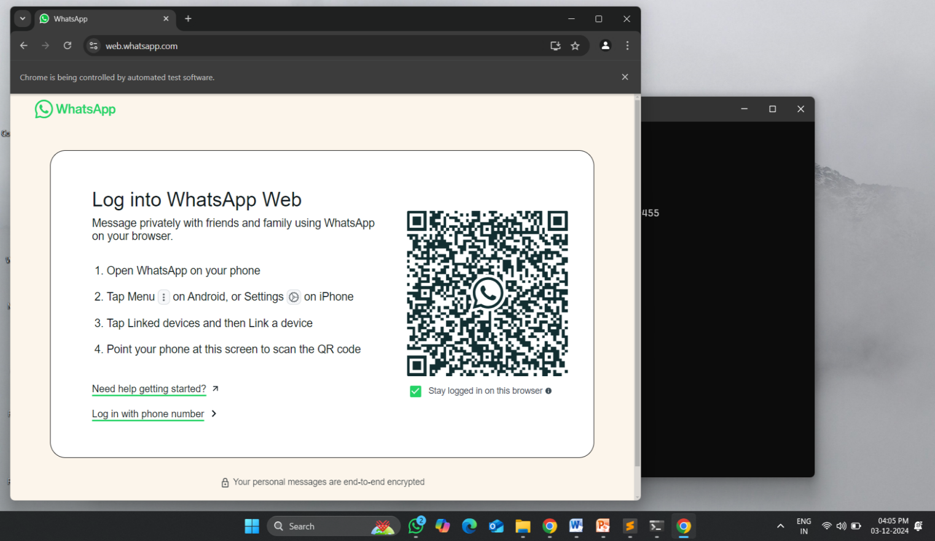
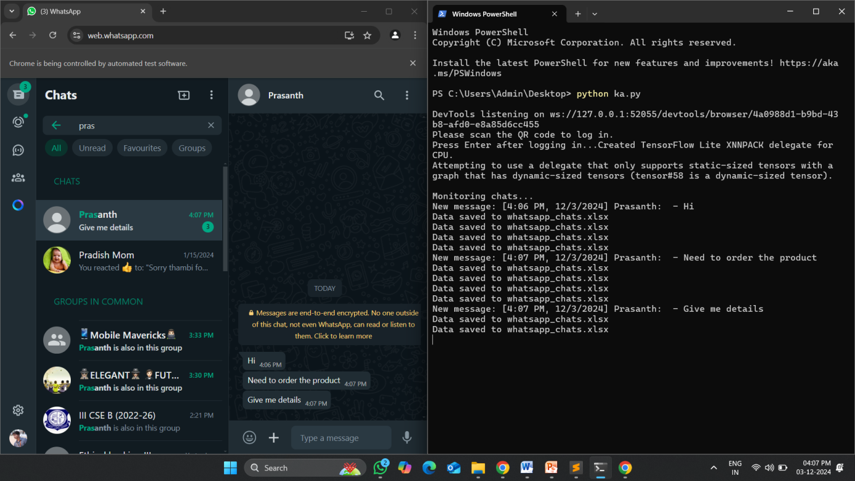
RESULTS AND DISCUSSION

Slide 16

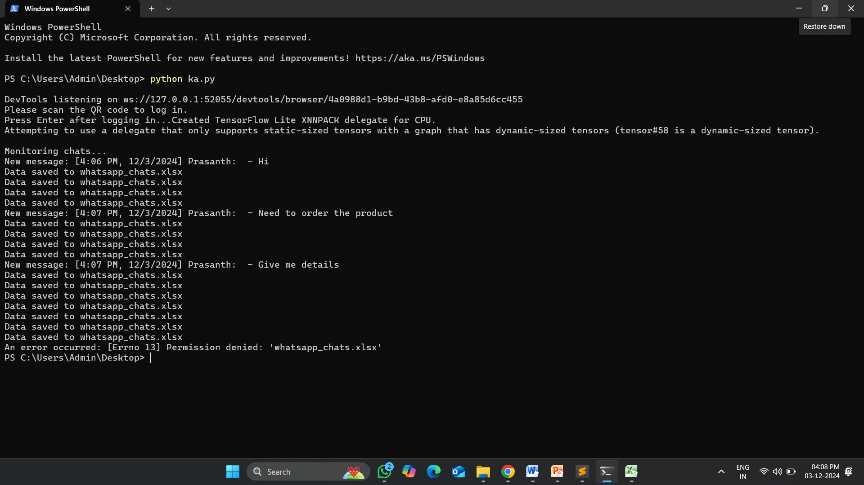

Slide 17
Discussion:
The approach reduced manual effort significantly, especially for users managing large volumes of chat data. However, the system's speed can depend on the internet connection and browser performance

Slide 18
CONCLUSION
The project successfully automated WhatsApp Web message retrieval, parsing, and storage, ensuring efficient and accurate data handling. It performed reliably under large datasets, with periodic updates through scheduling. While scalable and effective, future improvements like session re-login and database integration can enhance robustness.

Slide 19
THANK YOU

